Slide 1
F2F Meeting 12-07-24

Slide 2
Last meeting...
Carried out DEG analysis of ISC & Enterocytes
Did the first GO term/ KEGG pathway analysis
Subsequent Goals of last meeting:
- Create heatmap of marker genes for each cell annotation ⚠️
- Visualise GO/KEGG as upregulated/downregulated ✅
- Adjust number of top terms/pathways from 10 to 50 ✅
- Analyse more cell types (produced DEG files, now must pipe them)✅
- Compare mitochondrial gene set in the two groups ⚠️

Slide 3
Other progress ...
Reviewed scRNA-seq literature for best practices. ✅
Began the preprocessing step/annotation from scratch. ✅
Refined the code for carrying out the GO/KEGG analysis. ✅
Created GO analysis and KEGG pathway ‘functions’ which can be used to analyse multiple datasets at once. ✅

Slide 4
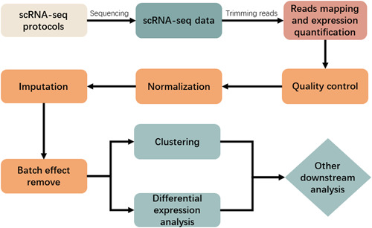
Began the preprocessing step/annotation from scratch
QC ✅
Doublet removal ✅
Normalization ✅
Imputation ⚠
Batch effect removal ✅
Clustering ✅
Manual Annotation ⚠
scRNA-seq workflow
https://www.ncbi.nlm.nih.gov/pmc/articles/PMC10190501/
Why?

Slide 5
‘Why’ continued...
Allows freedom for experimenting with preprocessing techniques (imputation, doublet removal, annotation & everything in between)
Much of the published code is not explained.
Constitutes a large section of scRNA-seq. Useful to learn.

Slide 6
Reviewed scRNA-seq literature reviews for best practices
Imputation
scRNA-seq data contains many false zero gene counts. ‘dropout’
“non‐biological zeros increase intercellular variability, blur the detection of gene‐to‐gene relationships, and may largely affect downstream analysis”
DGE analysis
“For an explanation of biological variations between two control groups, DEGs are essential. But differential expression analysis of scRNA‐seq data is hampered by technological variability, high noise, and huge sample sizes.”
“single‐cell differentially expressed gene identification methods can find hundreds of differentially expressed genes in the absence of biological differences.” - Solution: first integrate biological replicates to form pseudobulks
N.B. Still reviewing literature on downstream scRNA-seq analysis
Source: https://www.ncbi.nlm.nih.gov/pmc/articles/PMC10190501/

Slide 7
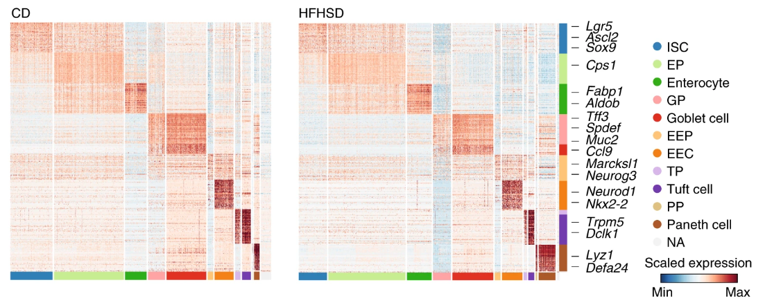
Heatmap of marker genes
Since the published cell annotations are used in my analysis we must use the published marker gene heatmap. Once the manual annotation is complete I can provide my own heatmap.

Slide 8
Refined the code for carrying out the GO/KEGG analysis
Divided the GO terms into activated/supressed
Added enrichment map to the GO analysis function (explained later)
Created functions to mass analyse the datasets for the different cell types.

Slide 9
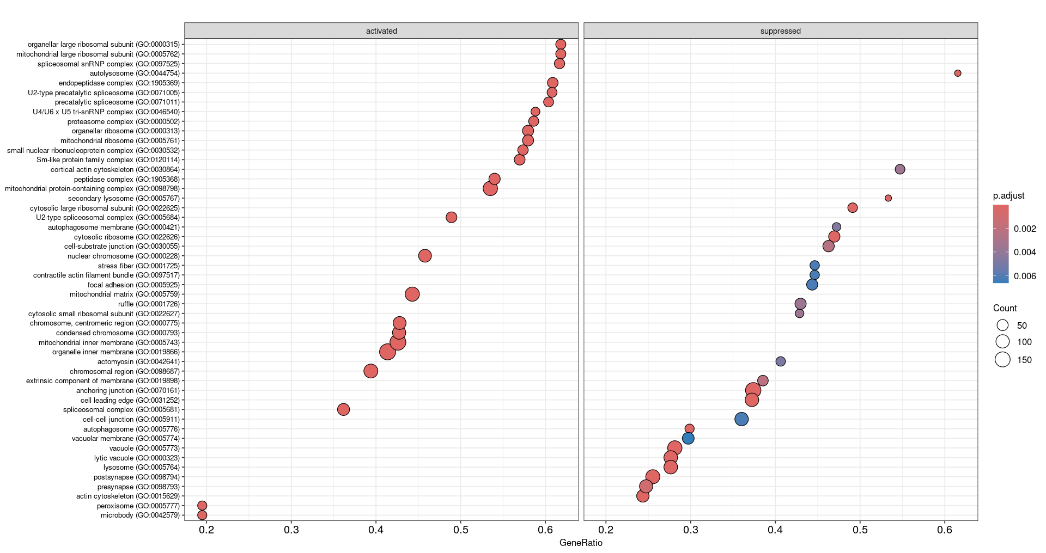
Visualise GO terms as up/downregulated
Cellular component - ISC

Slide 10
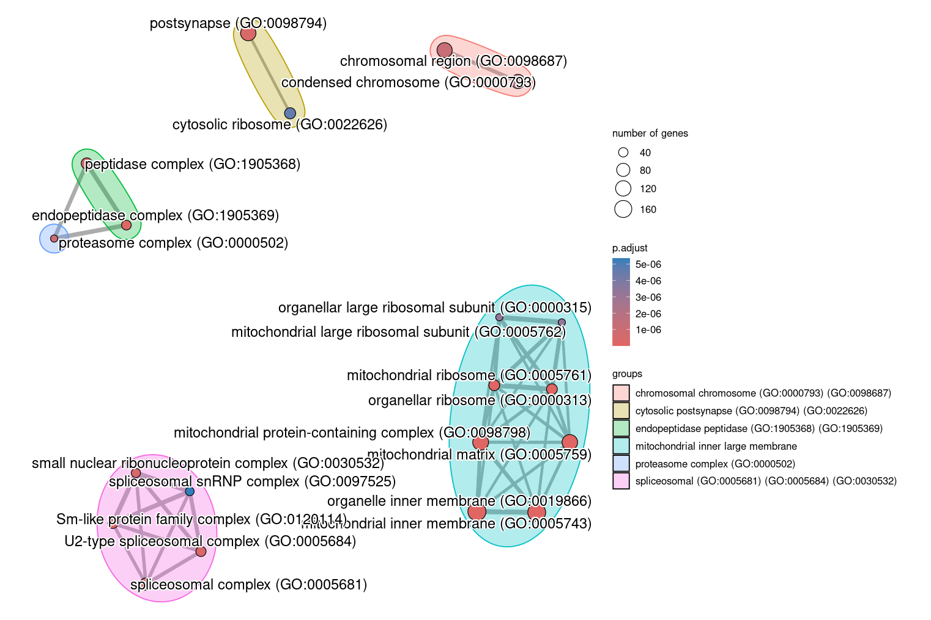
Enrichment Map
Cellular Component - ISC

Slide 11
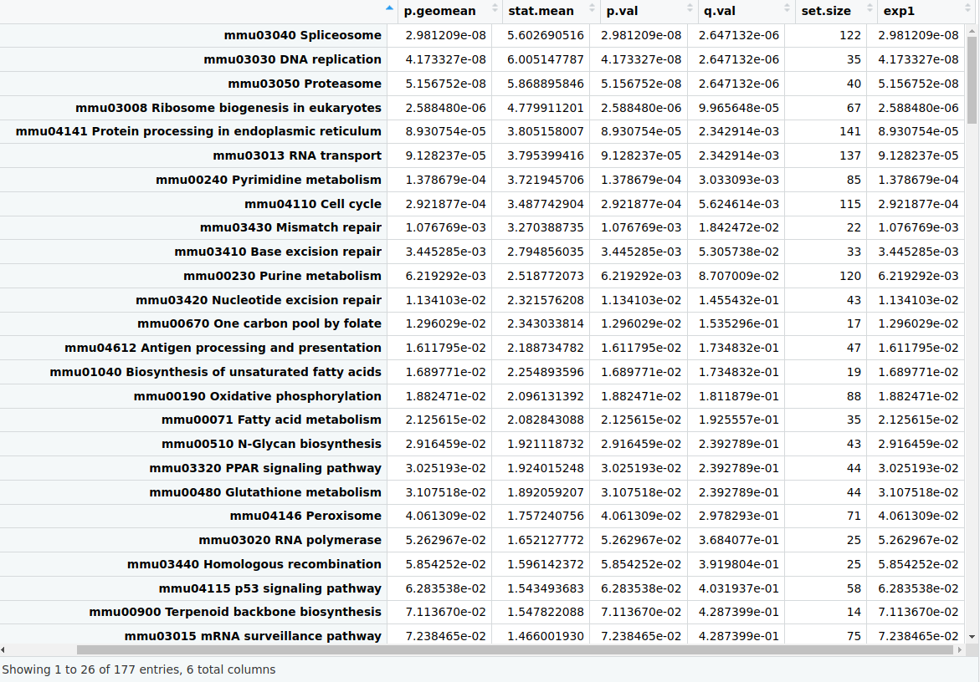
KEGG Pathways (activated)

Slide 12
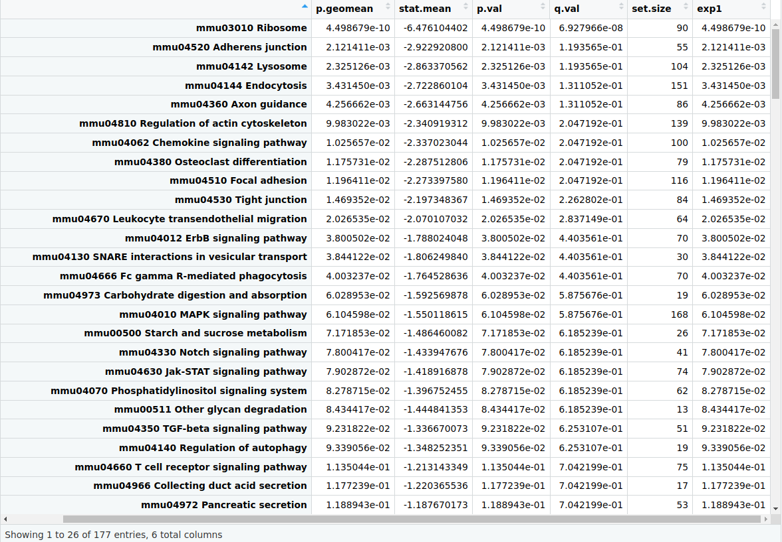
KEGG Pathways (suppressed)

Slide 13
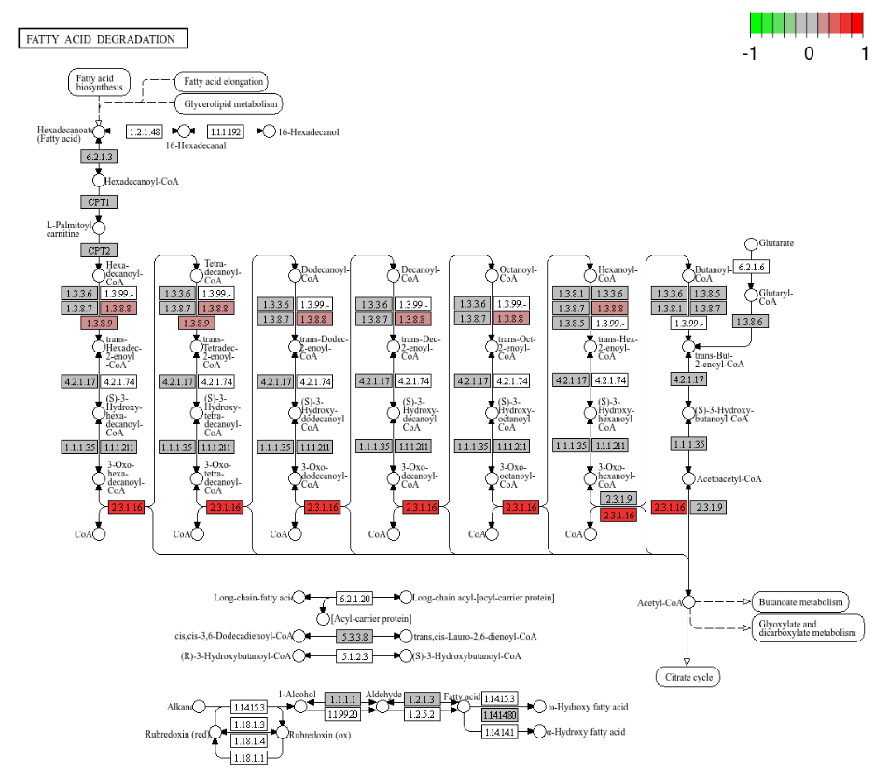
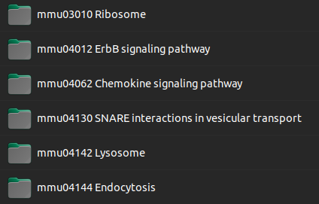
KEGG analysis function

Slide 14
Current Problems
The annotation process is long and tedious.
Coding/debugging/understanding how premade software works takes time.
Some KEGG pathway graphs are incompatible with the function (working on this)
Looking for a method for plotting the KEGG pathways as a barplot.

Slide 15
Future Work
Pseudobulk for a broader perspective of the data.
Run the other cell types through the pipeline
Begin to form biological hypotheses from the data and connect to current literature.

